Slide 1
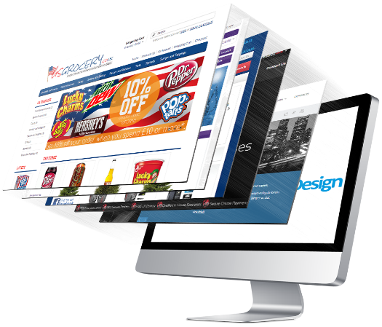
ICT Web Design
Lesson 1 – Principles of Web Design
V2.0

Slide 2
Lesson 1 - Principles of Web Design Objectives
3.1.1: Identify Web site domains, and relate a site's domain to its purpose.
3.1.2: Relate basic components of a Web page (e.g., color, space, written content, typography, images, links, multimedia) to aesthetic, functional and/or usable design principles.
3.1.3: Define aesthetic design, and explain how aesthetics can affect a visitor's perception of a Web site's information.
3.1.4: Demonstrate knowledge of color wheel concepts and effective use of color on a Web site.
3.1.6: Critique the aesthetic design, usability and accessibility of sample Web sites.

Slide 3
Web Site Categories & Domains
Top Level Domain
.com
.edu
.uk
.org
Identifies the type of organization to which the Web site belongs
Domain suffix, provides visitors with a clue to the purpose or location of the organization that owns the Web site
Server Name
www.totalbaseball.com
Top level Domain

Slide 4
Web addresses
Home address
Web address
Certification Partners 1230 West Washington St Suite 208 Tempe, AZ 85281-1247
www.certification-partners.com
IP: 50.63.202.1
Server (host) name: name given to a server (usually “www”)– assigned by the network administrator
Domain name: the registered company domain name
Top level domain: tends to identify what “type” of Web site it is
All 3 parts together create a “unique” address just like a street address

Slide 5
Top level domains

Slide 6
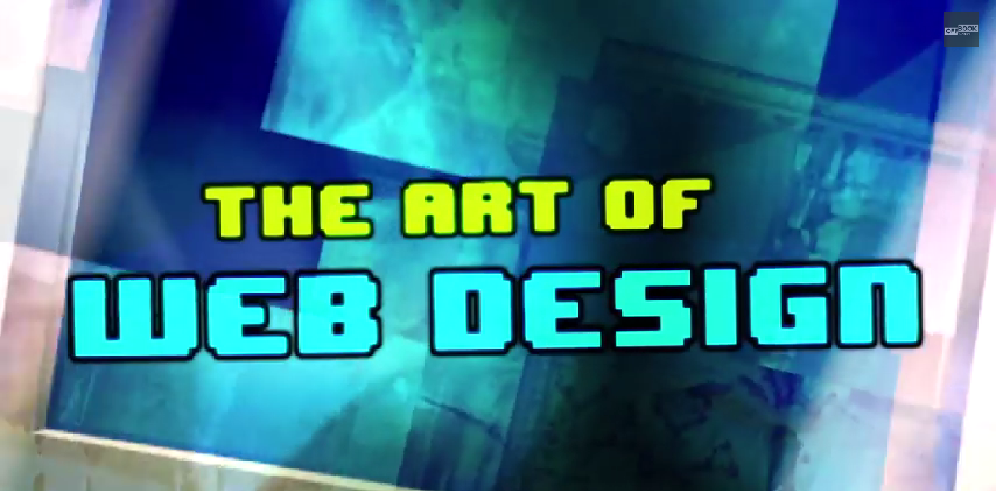
Aesthetic Web Design
https://www.youtube.com/watch?v=3iVVM_DgWY4

Slide 7
Aesthetic Web Design
What does aesthetics mean?
The look and feel of a Web site
How engaging it is to viewers
Invites exploration, etc.
Is more than just graphics and images:
Layout
Color scheme
Typography

Slide 8
Aesthetic Web Design - Layout
The layout helps form relationships and define meaning of page elements
Creates visual hierarchy and visual interest
Increases readability and usability
Should follow the CARP design principles
Contrast
Alignment
Repetition
Proximity
CARP

Slide 9
CARP
Contrast: Two or more page elements display differently in color, size, shape, texture, orientation, position or movement to group or separate elements on the page
Alignment: The placement, position, orientation and grouping of elements.
Repetition: Repeated elements can include colors, shapes, textures, fonts, typography, graphics, spatial relationships and so on.
Proximity: The use of white space and logical structure (such as grouping related items) to create visual unity.

Slide 11
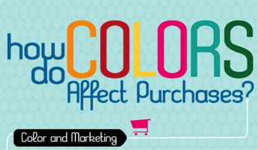
Aesthetic Web Design - Color
Web site’s color scheme should enhance the page and help establish or reinforce branding.
Should provide a good contrast
Color Psyhology Infographic

Slide 12
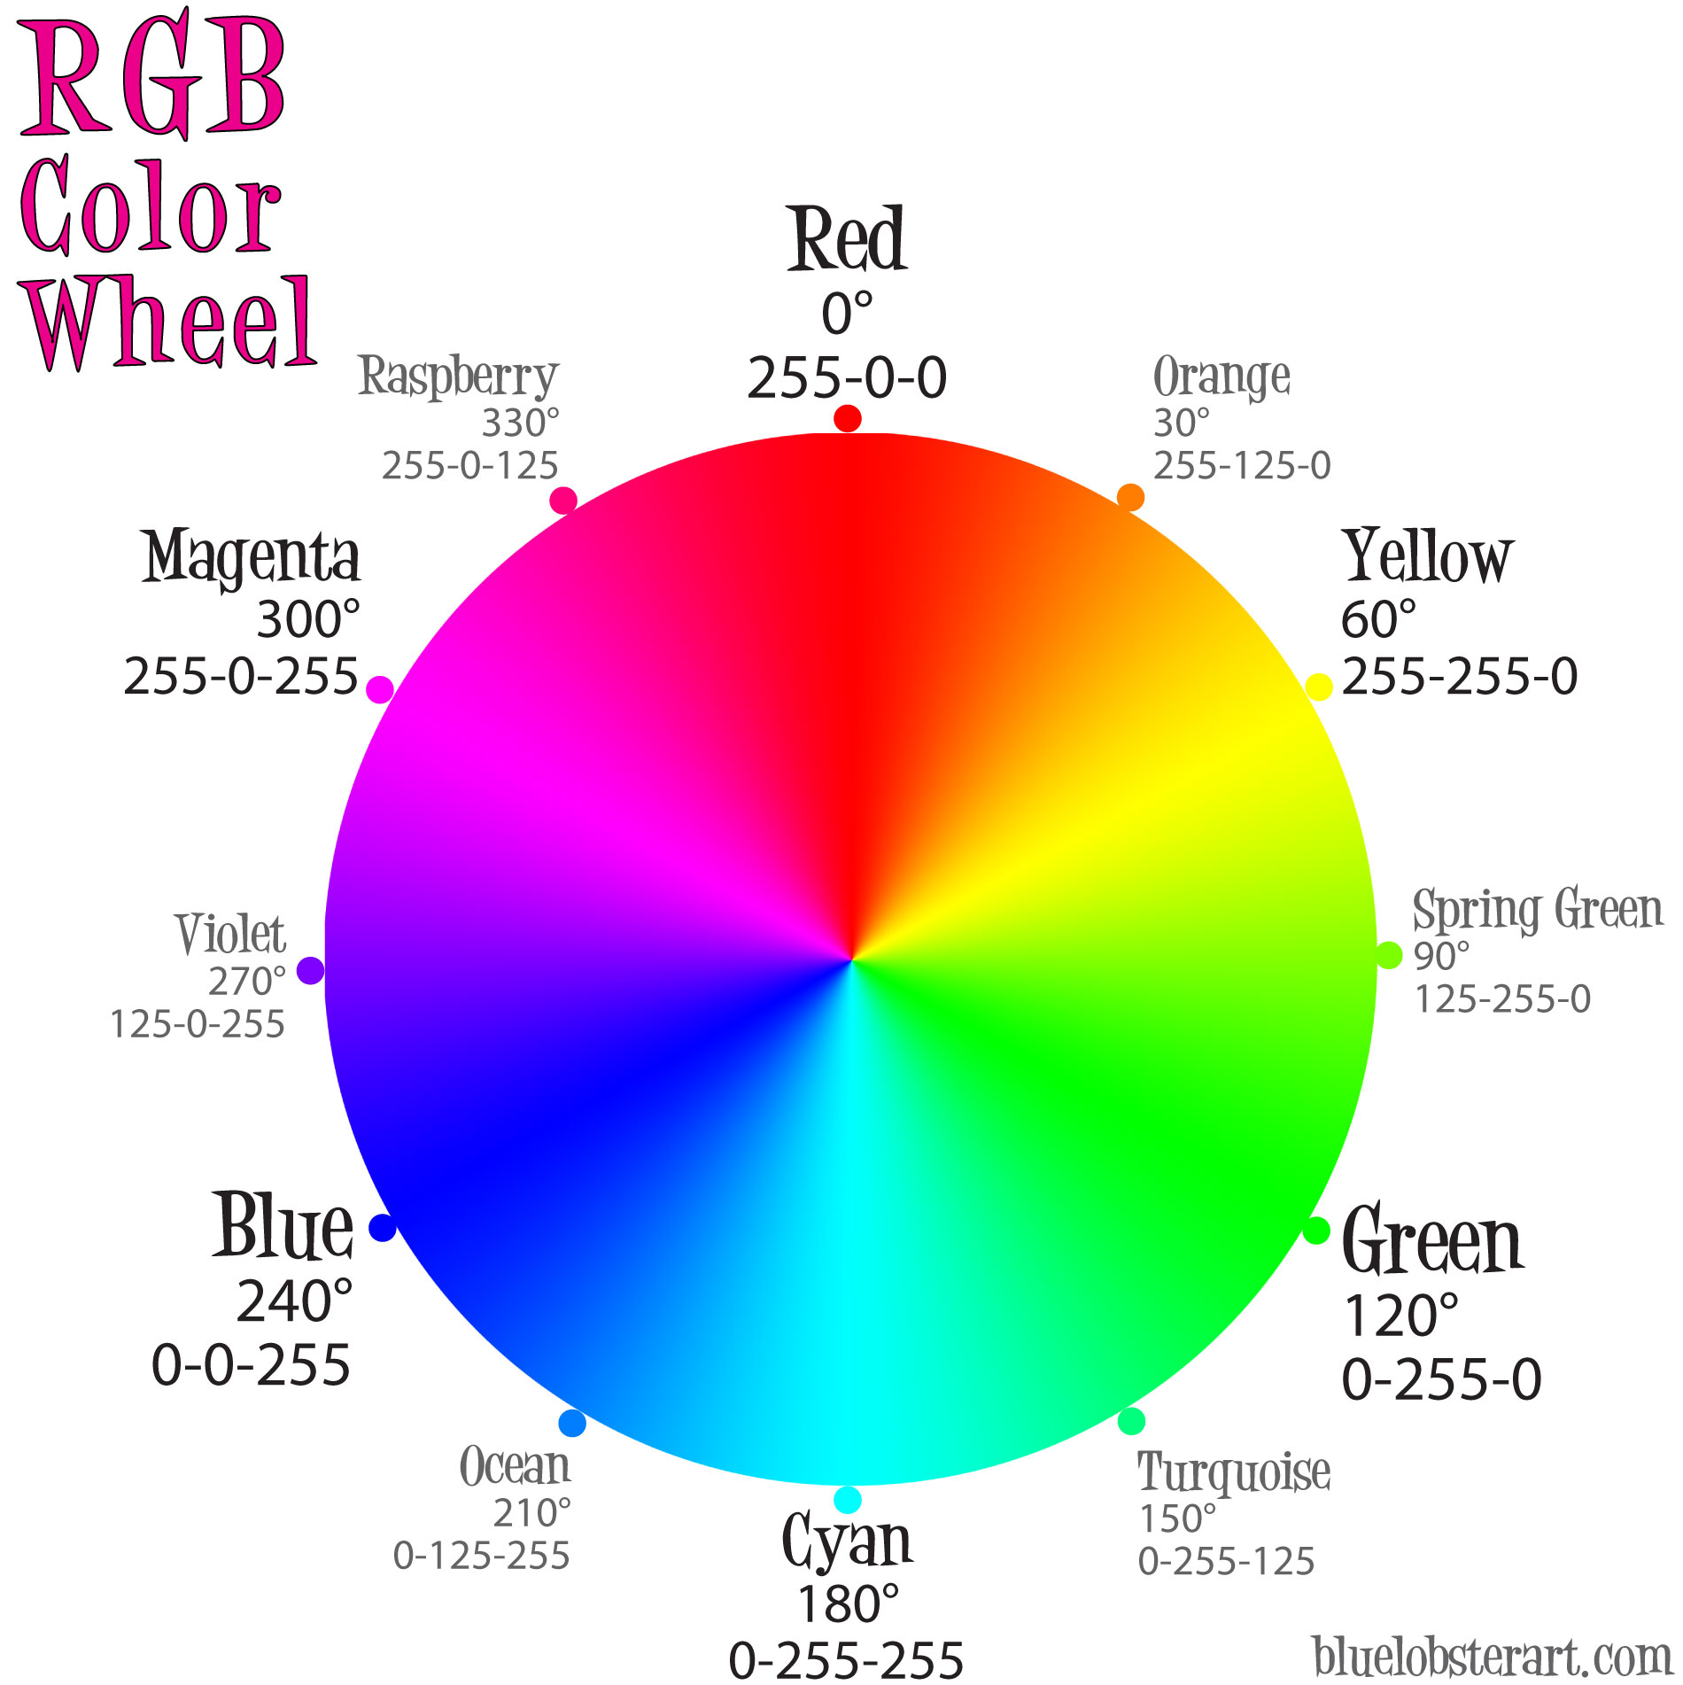
Color Wheel
Primary colors:
Red
Blue
Green
Secondary colors (Two Primary Colors)
Magenta
Cyan
Yellow
Tertiary colors (1 Primary & 1 Secondary)
Notes:
Take 10 minutes and research

Slide 13
Color Schemes
Monochromatic color schemes use varying colors, shades or tints of the same hue. (See Figure 1-6.) Start with a base color, generally darker, and then choose at least two other shades of the base color.
Analogous color schemes use colors that are next to each other on the color wheel. They are usually a good match and create eye-pleasing effects.
Complementary colors are across from each other on the color wheel.
Triadic colors are colors that are evenly spaced around the color wheel.

Slide 14
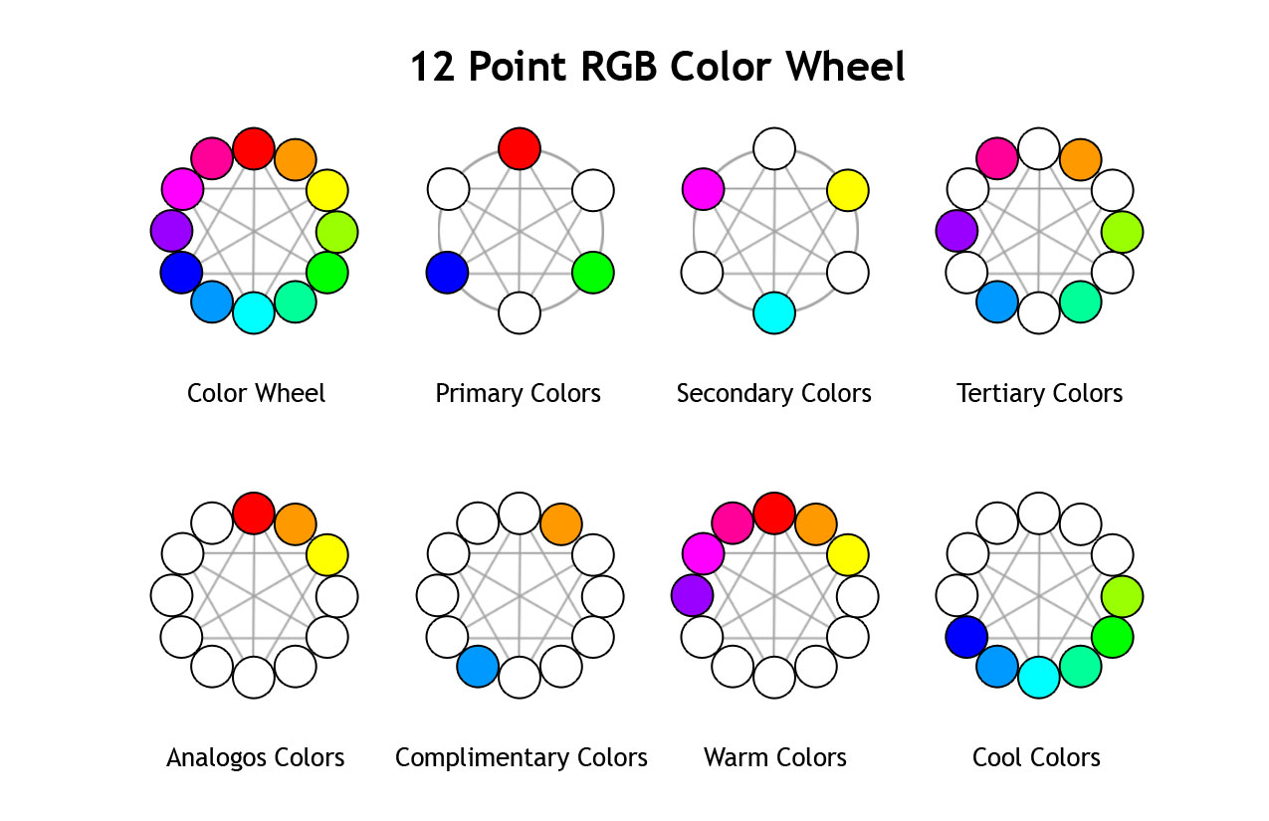
Color Schemes

Slide 15
Aesthetic Web Design - Graphics
Can enhance Web pages and help to create an engaging, interesting experience.
Popular graphics applications:
Adobe Photoshop
Adobe Fireworks
GIMP
Inkscape
Paint.net
Pixlr

Slide 16
Aesthetic Web Design - Graphics
High-quality, web-optimized images are needed
Raster – images made of pixels (small dots)
Vector – composed of lines and curves
Raster Image
Vector Image

Slide 17
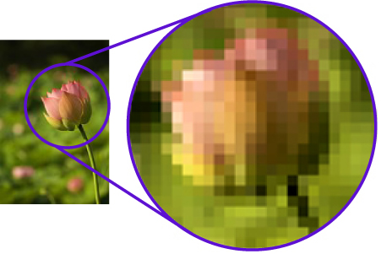
Bitmap - Raster
Made up of grid of pixels
File Extensions:
JPG (JPEG) – PNG – GIF – BMP - TIFF
Used for:
Graphics - pictures
Web & print
Loses clarity when enlarged

Slide 18
Graphics - Compression
JPEG | GIF | PNG
Use for photographs | Use for line art, cartoons, shapes, illustrations and drawings | Use for photographs, fine art drawings
Can be used for prints | Best used for electronic display | Best used for electronic display
Does NOT support transparency or animation | Supports transparency and animation | Supports transparency and supports animations with APNG extension
Lossy compression, small file size | Lossless compression, larger than JPEG and PNG | Lossless compression, larger file size than JPEG
Graphics should complement and be relevant to the Web site’s look and feel.
Media Compression:
Lossless compression = an image is compressed & all the information can be restored
Lossy compression = permanently eliminates certain information and image cannot be fully restored

Slide 19
Graphic File Formats
JPEG
PNG
Most common file type
No transparent background
“Lossy” compression – file is compressed from original size and loses some of it’s detail
Now commonly used on the Web
Does maintain a transparent background
“Lossless” compression
Animated with the .APNG extension

Slide 20
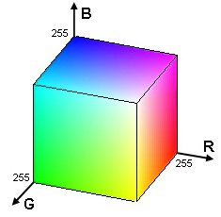
Common File Types
GIF
Can be animated
Maintains transparent background
Fewer colors (256 RGB)

Slide 21
Aesthetic Web Design - Typography
Typography is fun!
Typography is fun!
Typography is fun!
Typography is fun!
Color and font styles affect the “mood” of the text.

Slide 22
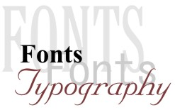
Fonts & Typography
Fonts
Fonts are the style of "type face" used to display text, numbers, characters and other "glyphs".
The most effective way to control font and other typographical styles is through the use of Cascading Style Sheets (CSS).

Slide 23
Fonts & Typography
Typography
Typography refers to the arrangement and appearance of text.
Typography concerns not only the look of the glyphs, but how they are placed on the page. Typography includes page margins, the amount of empty space between paragraphs or lines, the alignment of text, etc.)

Slide 24
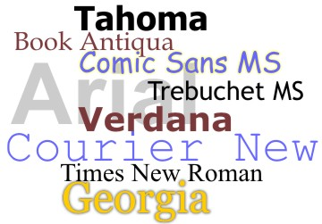
Fonts & Typography
Text as Graphics
Font Readability
It is important to use “real text” as opposed to text as graphics.
Text as graphics can become pixelated when enlarged
Best practice is to use the most readable fonts.
It is best to use fonts that are native to modern operating systems (installed on pc).

Slide 25
Font Families
Fonts are categorized into "families" based on their characteristics.
The most common font families are
serif
sans-serif
cursive
fantasy
monospace

Slide 26
Font Families
Serif fonts
Serif fonts are characterized by the flared extensions, or strokes, on the tips of such letters as f, l, and i, as seen in the screen shot below:
Serif fonts also usually have a combination of thick and thin strokes, as seen in the curve of the letter "f" above.
Examples of serif fonts include
Times New Roman
Georgia
Book Antiqua

Slide 27
Font Families
Sans-serif
Sans-serif fonts have plain endings, and appear blockier than serif fonts.
They do not have the flared extensions, strokes, or other kinds of ornamentation.
"Sans" means without, and "serif" refers to the extra strokes, or lines.

Slide 28
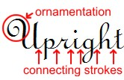
Font Families
Cursive
Cursive fonts resemble hand-written pen or brush strokes.
Often have artistic ornamentation, and sometimes have strokes that connect the letters together.
Generally more difficult to read - they are usually a poor choice in terms of usability or accessibility

Slide 29
Fantasy
Monospace
Monospace fonts get their name from the fact that each letter takes up the same width of space.
Even letters which might seem to require different widths, such as an uppercase "W" and a lowercase "i" take up the same width in monospace fonts.
Even the empty spaces between words are the same width as all of the letters themselves. Common monospace fonts are Courier and Courier New.
Both of these fonts have the appearance of old typewriter font faces, and are commonly used to display computer code, HTML markup, and other technical content.
Fantasy fonts are primarily decorative, and are not designed to be used as the main font for long passages of text.
Fantasy fonts vary wildly in their appearance and artistic content.
There are no elements or particular characteristics that categorize fantasy fonts other than their decorativeness.

Slide 30
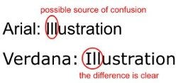
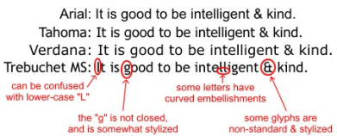
Electronic Media Fonts
Verdana
Tahoma
Verdana is one of the most popular of the fonts designed for on-screen viewing. It has a simple, straightforward design, and the characters or glyphs are not easily confused. For example, the upper-case "I" and the lower-case "L" have unique shapes, unlike Arial, in which the two glyphs may be easily confused.
Tahoma is another alternative to the Arial/Helvetica style of font.
Tahoma is somewhat larger than Arial, but smaller than Verdana. The spacing between letters in Tahoma is tighter than either Arial or Verdana, giving a somewhat "scrunched together" appearance, especially when compared to Verdana, and especially when used for long passages of text.

Slide 31
Proper use of fonts
Number of fonts
Use limited number of fonts
Using too many fonts can clutter the document and make it more confusing.
Documents with no more than 2 or 3 font faces look more organized, more streamlined, and more coherent.
Font Variations
Two elements in HTML create a bold text appearance, the <b> element and the <strong> element.
The <b> element has no semantic meaning. The <strong> element means "strong emphasis.”
If the purpose in using bold text is to emphasize content or give its meaning importance, the <strong> element is appropriate.
If the purpose is to simply present fatter text, the <b> is appropriate as this is purely cosmetic or stylistic.
Capitalization
Typing sentences or phrases IN ALL CAPITALS is rarely a good idea. It may make sense under some circumstances, but only rarely.

Slide 32
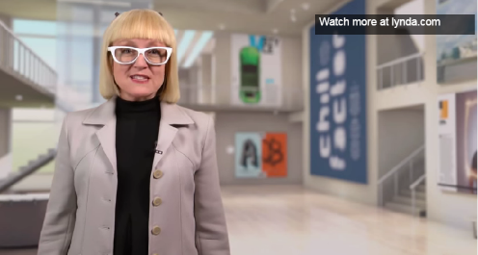
Aesthetic Web Design - Typography
Improve a Web site's readability, establish branding, and enhance the tone or style of the Web site
Font techniques link: http://webaim.org/techniques/fonts/
https://www.youtube.com/watch?v=Sdau-8CUQZw

Slide 33
Functional and Usable Design
Objectives
3.1.2: Relate basic components of a Web page (e.g., color, space, written content, typography, images, links, multimedia) to aesthetic, functional and/or usable design principles.
3.1.5: Compare functional and usable design principles, and explain how usability can affect a Web site's success.
3.1.6: Critique the aesthetic design, usability and accessibility of sample Web sites.

Slide 34
Functional and Usable Design
A functional Web site renders without error and functions as expected:
All internal and external links work
All forms of interactivity function
The page loads quickly

Slide 35
Functional and Usable Design
Usability assesses how easy a user interface is to use.
Measures the quality of a person’s experience while interacting with a Web site.
Anticipate and responds to the needs of visitors (FAQ)
Visitors can quickly and easily locate needed information

Slide 36
Functional and Usable Design – HCI and Writing Web Content
Human-Computer Interaction (HCI) = the study, planning, design and uses of the interaction between people and computers.
Learnability – How easy is it for people to use the first time they try?
Efficiency – Once users are familiar with the design, how quickly can they do what they want or need to do?
Memorability – If someone doesn't use the design for some time, how easy will it be for them to become familiar with it again?
Errors – How many errors users make, how quickly do they recover from them and how much trouble is it to fix?
Satisfaction – How pleasant is it to use this product?

Slide 37
Functional and Usable Design – HCI and Writing Web Content
Writing Tips for the Web:
Do not use industry jargon or slang
Be cautious using humor or clever headings
Write headings that clearly communicate the content of the Web page or subtopic
Do not underline text or headings. They may be confused for hyperlinks

Slide 38
Functional and Usable Design – Browser Compatibility
Web sites should be tested in variety of browsers and devices to verify that they display consistently

Slide 39
Functional and Usable Design – Accessibility
Accessibility is the practice of making Web sites usable by people of all abilities and disabilities.
Provide text links as an alternative to image links.
Choose a high amount of contrast between page background and text colors.
Do not use color alone to convey meaning, because you will exclude people who are color blind or use screen readers.
Provide alternative text description for images and other visual elements.
Summarize tables and provide headings as appropriate for line-by-line reading.
Provide transcripts for audio and captioning for video.

Slide 40
Multi-media & Interactivity
Objectives
3.1.7: Define multimedia, and identify its role in Web page interactivity.

Slide 41
Multimedia and Interactivity
Multimedia is the combined use of audio, video, animation and other interactive features.
Common Web page interactivity components
Clicking a link
Moving the mouse to cause an image to appear
Clicking buttons on a form or survey
Customizing a Web page view or contents
Watching a video or listening to audio
Taking surveys or live chats
Multimedia and interactivity can make Web pages more interesting and informative

